Slide 1
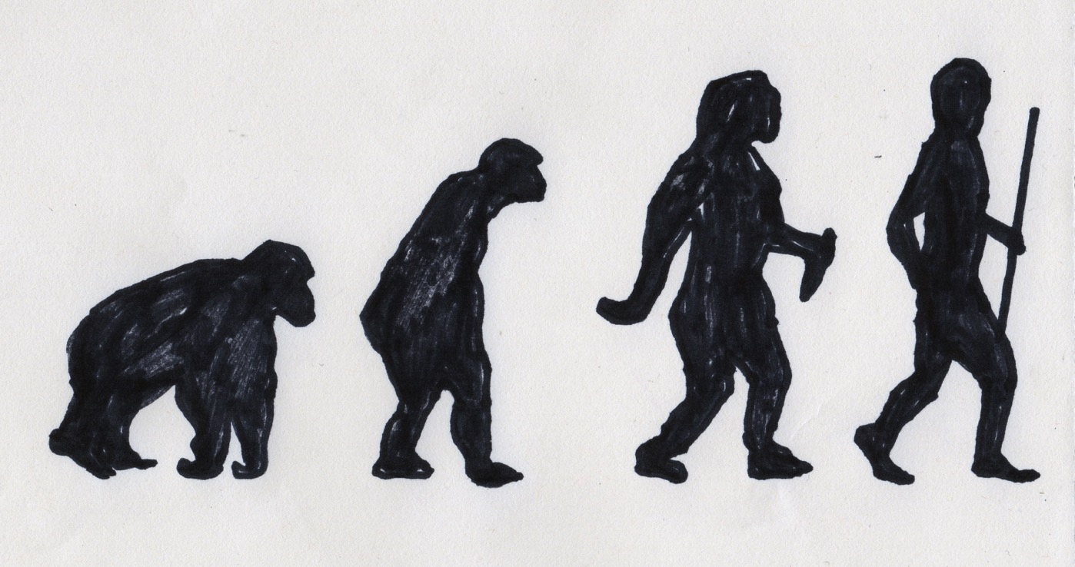
Notes:
Evolution of man depicted through a sequence of images
Image: Nicky Arscott

Slide 2
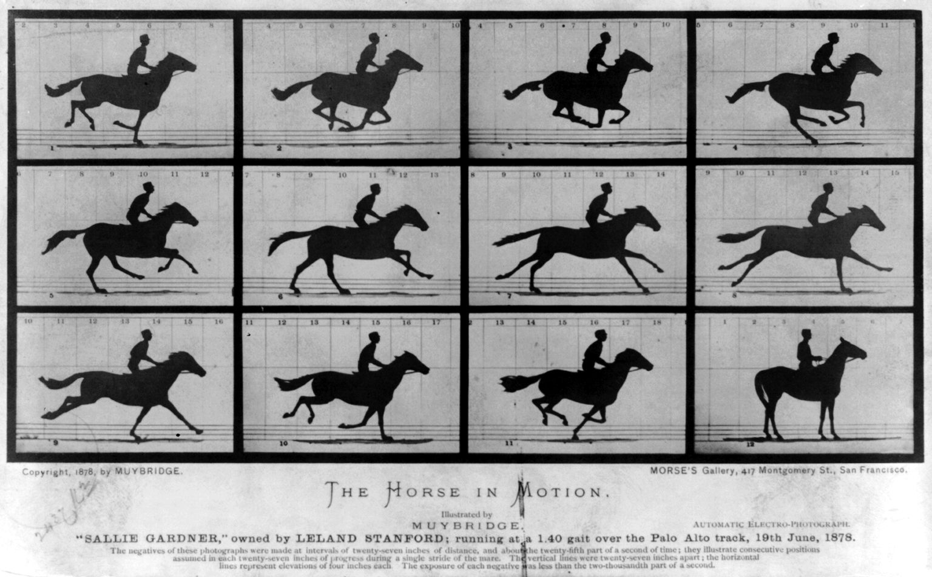
Notes:
‘The Horse in Motion’ by Eadweard Muybridge 1878, a series of photographs often cited as an example of early silent film (https://commons.wikimedia.org/wiki/File:The_Horse_in_Motion.jpg)

Slide 3
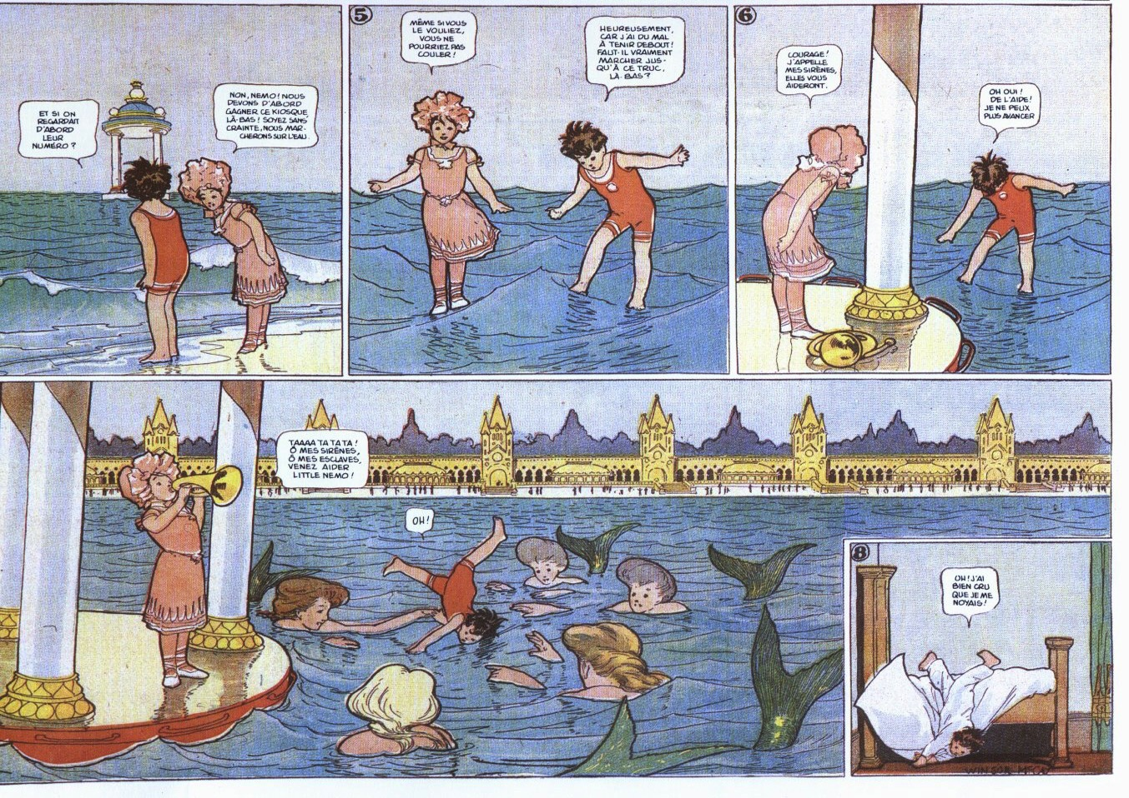
Notes:
‘Little Nemo in Slumberland’ by Winsor McCay 1905-1914: an early example of comic art (http://commons.wikimedia.org/wiki/File:Little_Nemo_sea.jpg)

Slide 4
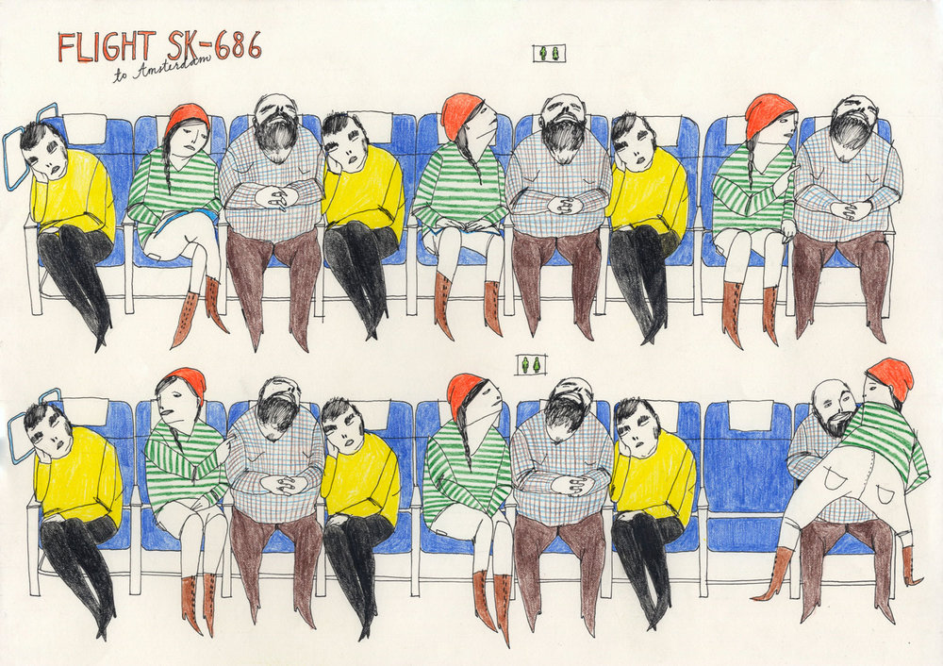
Notes:
‘Flight SK-686’ by illustrator Emma Hanquist, used with kind permission of the artist

Slide 5
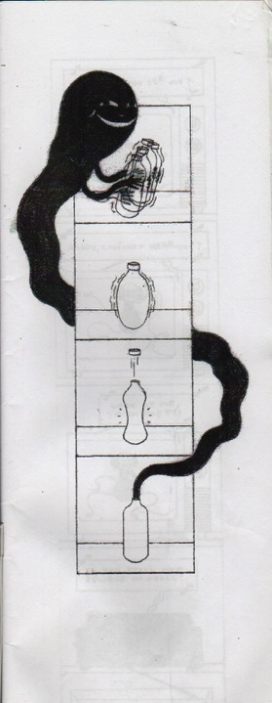
Notes:
Untitled illustration by Vincent Fritz (below) plays with the concept of beginning and end (used with kind permission of the artist)

Slide 6
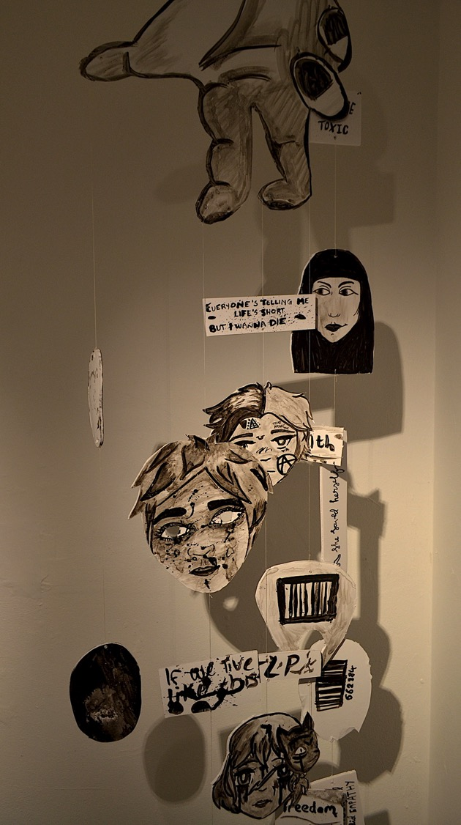
Notes:
A piece from ‘Mobile Tales’ by Criw Celf students in Powys, exploring telling stories through hanging mobiles (photograph by Nicky Arscott)

Slide 7
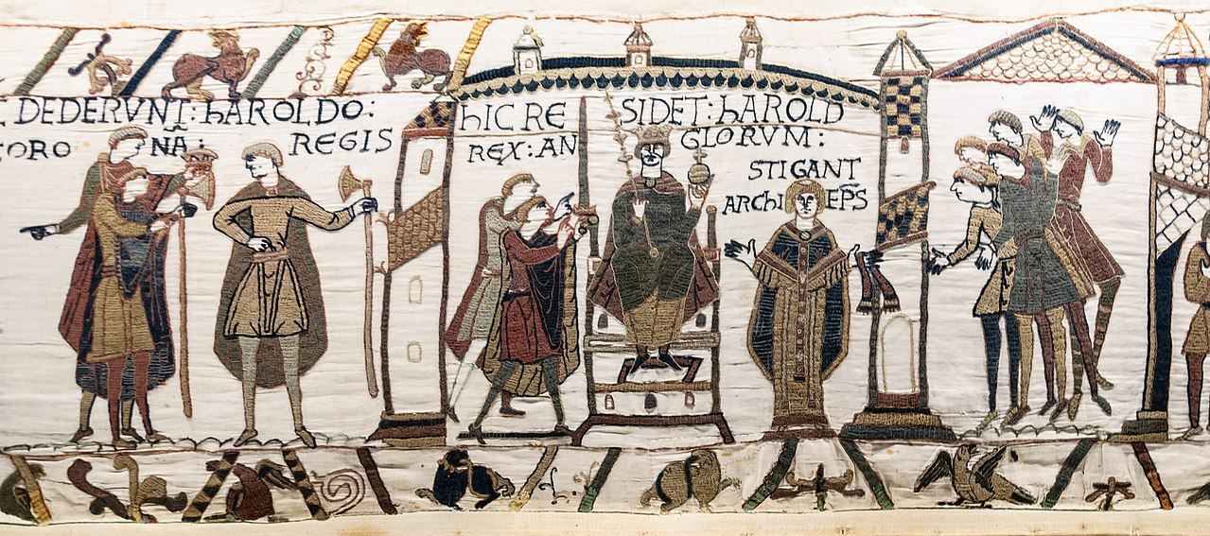
Notes:
Detail from the 11th century Bayeux Tapestry which is 70m long and depicts the events leading up to the Norman conquest (https://en.wikipedia.org/wiki/Bayeux_Tapestry#/media/File:Bayeux_Tapestry_scene29-30-31_Harold_coronation.jpg)

Slide 8
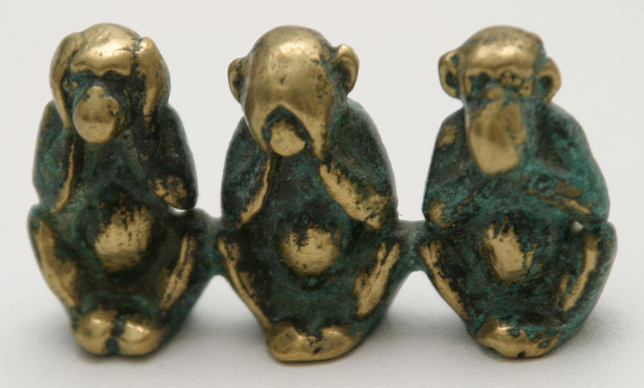
Notes:
‘Three Wise Monkeys’ brass sculpture (above) represents the proverb ‘hear no evil, see no evil, speak no evil’ (image by Tumi 1983 https://commons.wikimedia.org/wiki/File:Three_wise_monkeys_figure.JPG)

Slide 9
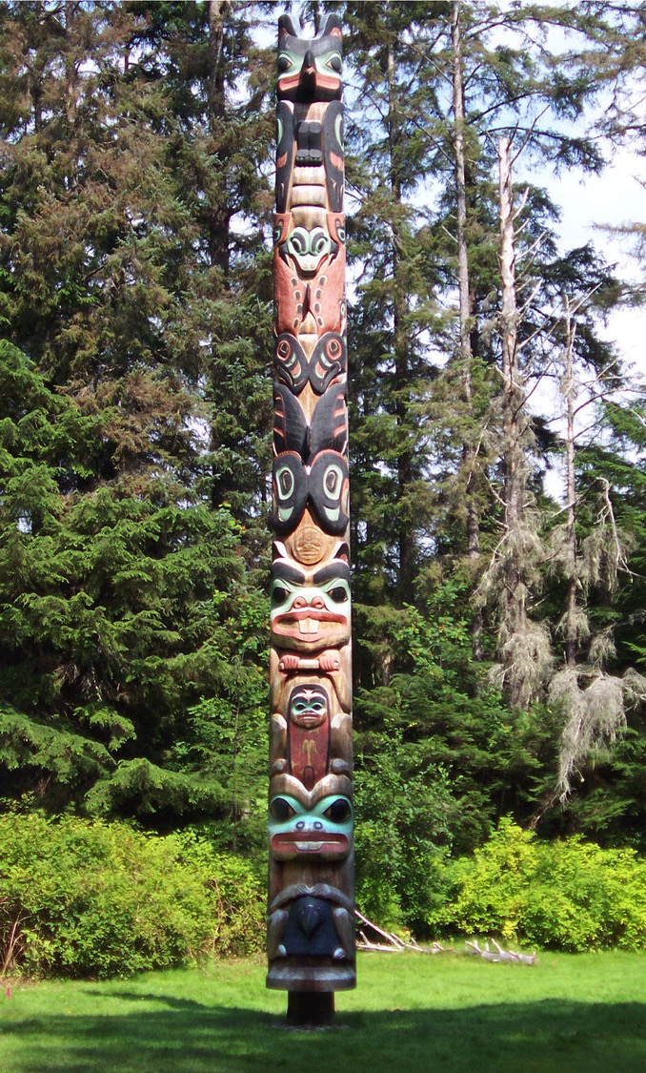
Notes:
The K'alyaan Totem Pole of the Tlingit Kiks.ádi Clan, (left) erected at Sitka National Historical Park (Alaska, USA) to commemorate the lives lost in the 1804 Battle of Sitka. Photograph by Robert A. Estremo, copyright 2005 https://creativecommons.org/licenses/by-sa/2.5/deed.en

Slide 10
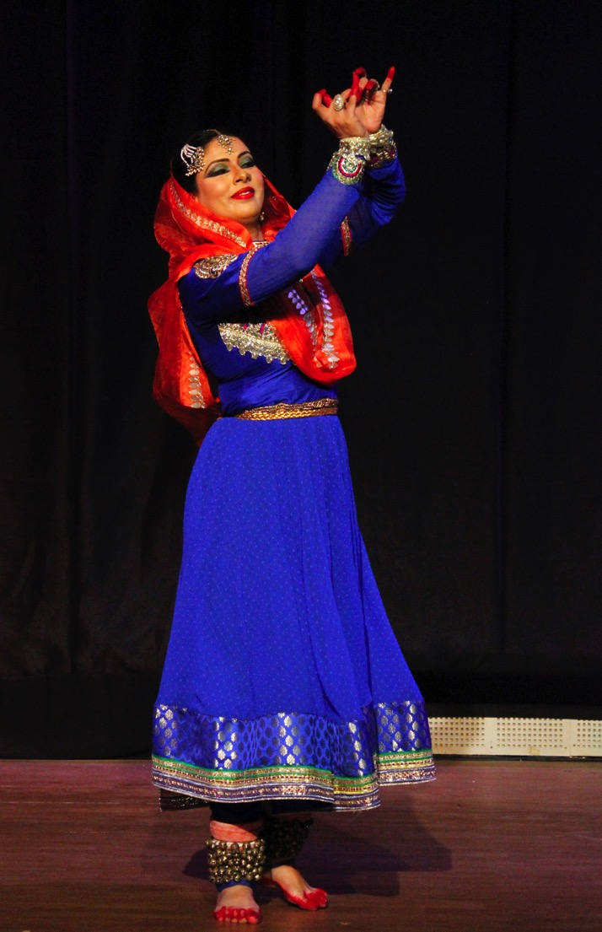
Notes:
Kaathak dancer, India. Kathak is traditionally attributed to the travelling bards of ancient northern India, known as Kathakars or storytellers. The story is told through a developed vocabulary based on the gestures of arms and upper body movement, facial expressions, stage movements, bends and turns. Photograph by Suyash Dwivedi 2017 https://creativecommons.org/licenses/by-sa/4.0/deed.en

Slide 11
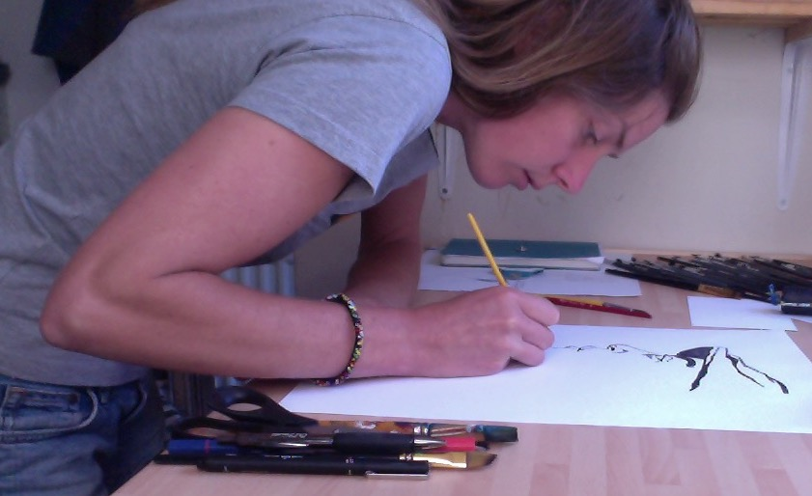
Nicky Arscott: “I wanted to find an interesting way to show Eric’s ‘flight’ from the country of his childhood – one symbol of his identity that would be repeated throughout the comic. I asked him what bird he would be, if he could be any bird at all. His answer was:
How i wish to be an Ezruli To suck nectar from hibiscus flowers That morning breezes may blow me, Hither and thither, From the streams of Namonge Behind my mother’s house, To the roof of Mongo Mo Ndemi, the giant. I wish. (“Ezruli” is the smallest bird
in the ‘Sun bird’ family).”

Slide 12
“. ... the genre needs to be defined fundamentally as an inextricable combination of both comics and poetry, neither of which should be dispensable. In the best poetry comics, I believe, the piece would fail utterly (or at best be horrifically diminished) if you removed either the poetry or the artwork from the composition."
--Chrissy Williams, editor, Over the Line:
An Introduction to Poetry Comics

Slide 13
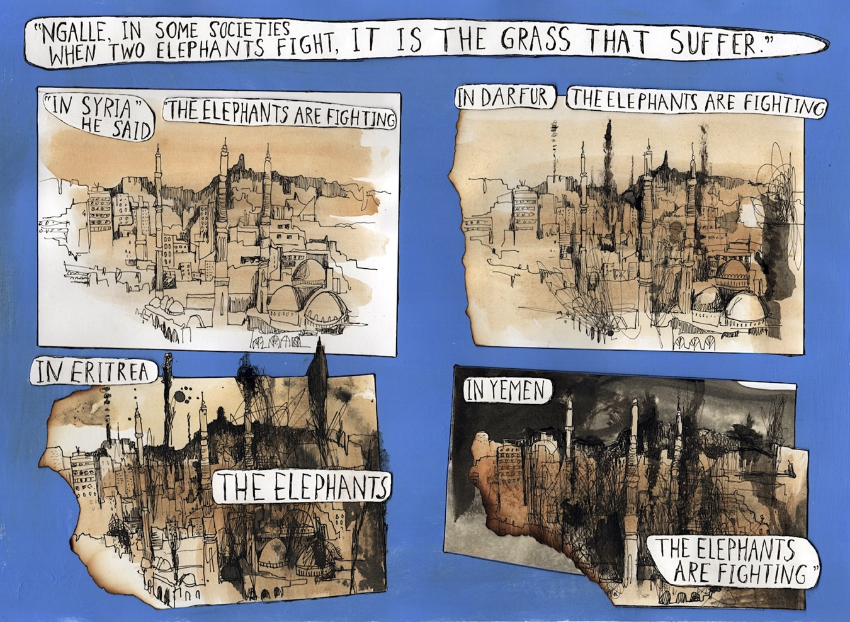

Slide 14
REFUGEE
ASYLUM SEEKER
ILLEGAL IMMIGRANT
ECONOMIC MIGRANT
EX-PAT

Slide 15
Refugee
“A person who owing to a well-founded fear of being persecuted for reasons of race, religion, nationality, membership of a particular social group or political opinion, is outside the country of his nationality and is unable or, owing to such fear, is unwilling to avail himself of the protection of that country; or who, not having a nationality and being outside the country of his former habitual residence as a result of such events, is unable or, owing to such fear, is unwilling to return to it.” (Definition of a refugee according to The 1951 United Nations Convention Relating to the Status of Refugees)
About 85% of the world’s refugees are living in developing countries, often in camps. Turkey is the biggest refugee hosting country in the world. It is currently providing safety to 3.4 million Syrian refugees. In 2017, 1 in 6 people in Lebanon people was a refugee. By the end of 2018 the UK had resettled 13,961 Syrian refugees. In the UK in 2018, 30% of people who applied were granted protection. (Source: Refugee Council)

Slide 16
Migrant
While there is no formal legal definition of an international migrant, most experts agree that an international migrant is someone who changes his or her country of usual residence, irrespective of the reason for migration or legal status. (United Nations Department of Economic and Social Affairs)

Slide 17
Asylum-seeker
An asylum-seeker is a person who has left their country and is seeking protection from persecution and serious human rights violations in another country, but who hasn’t yet been legally recognized as a refugee and is waiting to receive a decision on their asylum claim. Seeking asylum is a human right. This means everyone should be allowed to enter another country to seek asylum. (Amnesty International)
The UK asylum system is strictly controlled and complex. The decision-making process is extremely tough and many people’s claims are rejected. Most asylum seekers are living in poverty and experience poor health and hunger. Almost all asylum seekers are not allowed to work and are forced to rely on state support – this can be as little as £5 a day to live on. There is no such thing as an ‘illegal’ or ‘bogus’ asylum seeker. Under international law, anyone has the right to apply for asylum in any country that has signed the 1951 Convention and to remain there until the authorities have assessed their claim. It is recognised in the 1951 Convention that people fleeing persecution may have to use irregular means in order to escape and claim asylum in another country – there is no legal way to travel to the UK for the specific purpose of seeking asylum. (Source: Refugee Council)

Slide 18
Illegal Immigrant
“There are a variety of commonly understood reasons why people are identified as “illegal immigrants”. A person may cross a border against the rules of the country they’re entering. Someone may have been living in a country according to its rules until their visa expired, was cancelled, or they could no longer meet its conditions. A person’s status might also change without them knowing – sometimes people are even identified as “illegal immigrants” in their home country.” Tendayi Bloom, The Conversation
Some people disagree with using the term ‘illegal immigrant’: “There are vast numbers of people in the UK, including children born or raised here, who become overstayers or undocumented because the immigration system is impossible to navigate & the fees are simply too high. Just something to think about next time you use the word 'illegal'” (Satbir Singh, CE, Joint Council for the Welfare of Immigrants)

Slide 19
Ex-Pat
Wikipedia defines an expatriate (often shortened to ‘expat’) as a person temporarily or permanently residing in a country other than their native country. The term 'expatriate' is also used for retirees and others who have chosen to live outside their native country.

Slide 20
Example: Visual/literary device Effect
“The elephants Metaphor (for Shows individuals’
are fighting” war / power) powerlessness in the face of war/ circumstance

Slide 22
GLOSSARY
abstract art – less literal in its attempt to represent reality; non-realistic
Bakweri – a language spoken by the people of the foot of mount Cameroon, closely related to the Bantu Language
djembe – a drum, originally from W. Africa. The Malinké people say that a skilled drummer is one who "can make the djembe talk"
image – a representation of something; a picture
Jukuke - a fearsome Devil, ill omen
literal - taking words in their most basic sense without metaphor or exaggeration
media – mass communication outlets e.g. publishing, internet, broadcasting
metaphor – a figure of speech in which a word or phrase is representative of something else (to which it is not literally applicable)
Mevomba - sidekick to Jukuke: together these two are extremely dangerous
myth – a traditional story, sometimes trying to explain something in society or the environment, and often containing gods or supernatural beings
narrative – presentation of a sequence of events, words, or images telling a story
personification – the attribution of human characteristics to something non-human
proverb – a saying; a ‘truth’
sequence – a series of images, events or words that follow each other in a particular order
symbol – one thing that stands for something else, sometimes a material object representing something abstract
visual metaphor – the representation of something by means of a visual image; an image that is meant to be understood as a symbol for something else

Slide 23
USEFUL LINKS
Creating Safe Spaces teaching resource by PositiveNegatives:
https://www.tes.com/teaching-resource/creating-safe-spaces-12081148
Tackling Racism teaching resource:
https://hwb.gov.wales/repository/resource/68555df8-a891-42ff-8b37-8cacef08ac7d/en
School of Sanctuary Teaching Resources:
https://www.tes.com/teaching-resource/school-of-sanctuary-resources-asylum-seekers-and-refugees-11715917
Using visual narratives to support understanding of poetry in children: https://www.researchgate.net/publication/332396481_How_can_creating_visual_narratives_support_understanding_of_poetry_in_children_aged_12-14_years
UNHCR Teaching Resources
https://www.unhcr.org/uk/teaching-about-refugees.html
Refugee Action: support and advice for refugees and asylum seekers
https://www.refugee-action.org.uk/
Just For Kids Law: support, advice and legal help for young people in difficulty
https://www.justforkidslaw.org
Migrant Help UK: independent advice and guidance to assist asylum seekers in the UK move through and understand the asylum process; able to give advice on rights and entitlements but not able to provide legal advice or legal representation. If they cannot help, they will provide you with a list of qualified legal representatives.
https://www.migranthelpuk.org/
Wales PEN Cymru / PEN International: supporting writers worldwide
http://walespencymru.org/ | https://pen-international.org/

Slide 24
TRANSLATIONS
Welsh:
Siarad Cymraeg?
Do you speak Welsh?
Dim! Dwi’n hoffi trio siarad Cymraeg
No! I like to try to speak Welsh
Croeso
Welcome
Bakweri:
Mama-ma weloooo, Njiya Ne Njiyalene
Tata-Ma Welooo Njiya Ne njiyalene
Wama Nuka Too Mooli mekolikoli Zri Ngweya Zruu
Zri Na muko Moli Mekolikoli Zri Na Ngweya woo
Zri Nene Jujuke Na Mevomba
wa neya ene zre ya mawongor
These lines are translated on page 14 of the comic. As you cross the Bakweri landscape, you will hear different versions of this song. In one version, the warning comes as a note: the mother and father were killed by Jukuke and Mevomba, so the note warns villagers that upon reaching the top of Mooli mekolikoli (the hill) they mustn’t show any signs of tiredness, else Jukuke and his friend will appear and that will be it.

